Slide 1
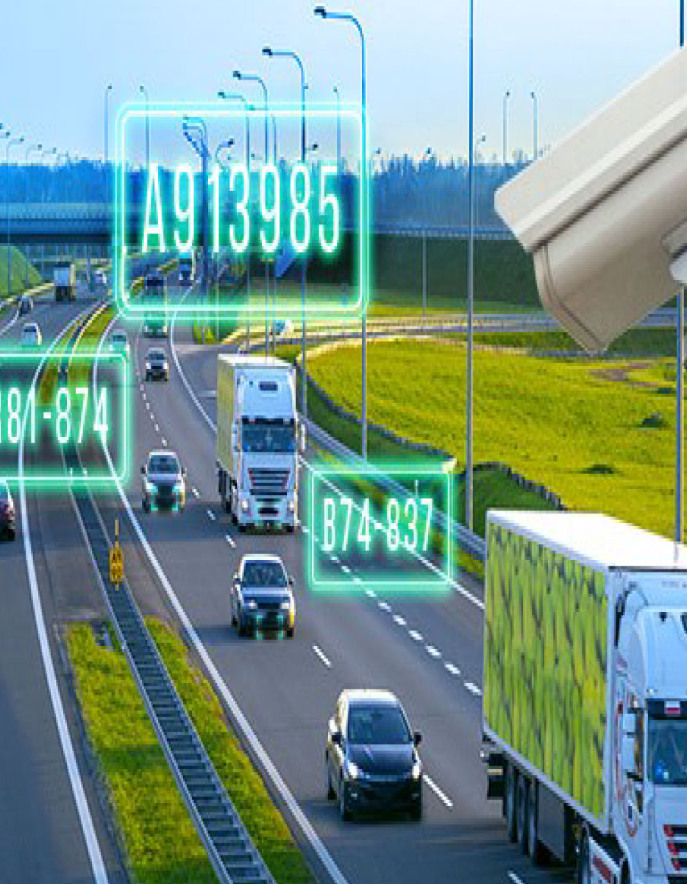
Moving vehicle registration plate detection and analysis
Team-2
Apuru Rohan(1602-20-737-098)
Varkala Sujith Atesh(1602-20-737-114)
Gumidelli Sandeep(1602-20-737-102)

Slide 2
Agenda
1
2
3
4
5
Problem Statement
Solution Approach
Use cases
Results
Future Scope

Slide 3
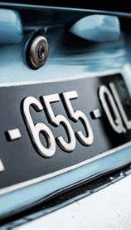
Problem Statement
To create an anti-theft auto security system that can extract registration number from number plate of moving vehicle. And can capture and store the data, which can be available for further analysis of theft or proof reading.

Slide 4
Solution Approach​
Detection
Recognition
Analysis
The vehicles coming in and going out are captured using live feed. They are recorded and sent to the model. The YOLOv5 model detects the number plate in the sent frame. It returns the co ordinates of the number plate.
The dimensions of the detected number plate frame is given to the reader of EasyOCR.
EasyOCR returns the image in text form. This text from is refined to obtain the Indian number plate from it.
The detected license plate is sent to Levenshtein algorithm to get the best fit number plates among the registered ones.
The number plate obtained is checked with its entry time and exit time based on the gate at which the vehicle is detected.
If any duplicate vehicle tries to enter or if any unregistered vehicle tries to enter, the alarm is fired to indicate the duplicates. The system goes back if alarm is signaled.

Slide 5





Flow Of the System
Registration
Register a new vehicle into the database.
Detection
Detect the number plate at the entry and exit gates
Analyze
Check if the vehicle is already registered or any duplicate entry
Record the data
Update the entry/exit time according to the detected place
Grant the access
Vehicle will enter smoothly if alarm does not fire.

Slide 6
Use Cases
Registration of new vehicle
License plate detection
Duplicate license detection
Check for status of the vehicle
Entry and exit logs

Slide 7
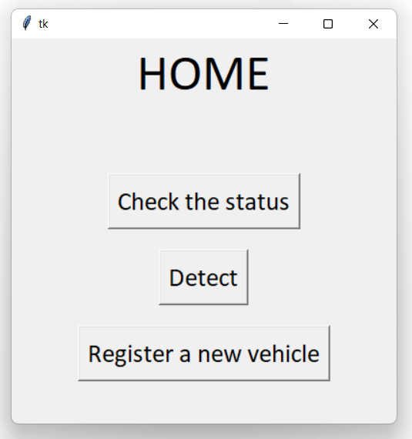
Results

Slide 8
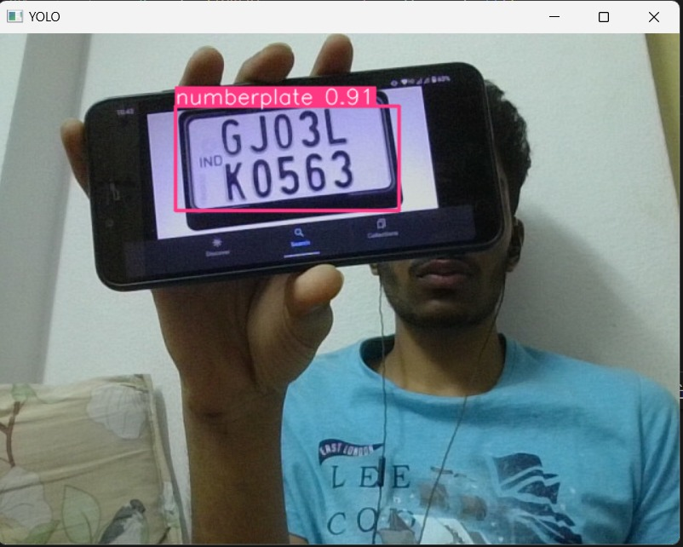
Results(Contd..)

Slide 9
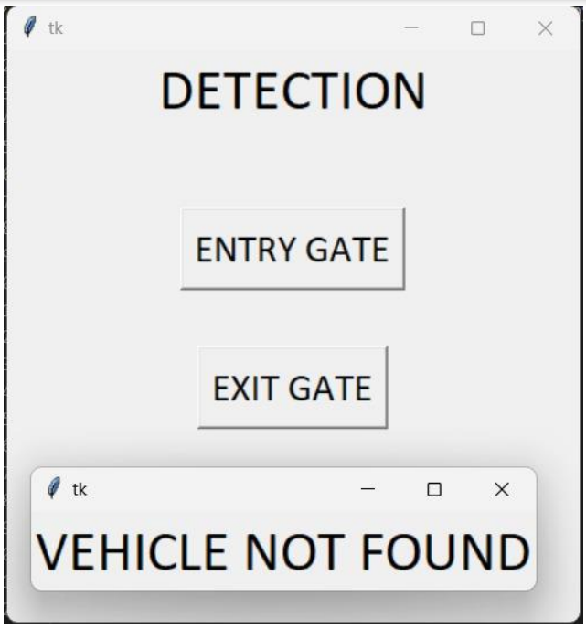
Results(Contd..)

Slide 10
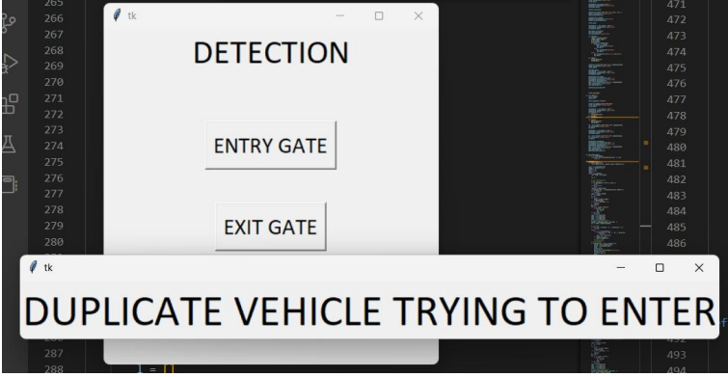
Results(Contd..)

Slide 11


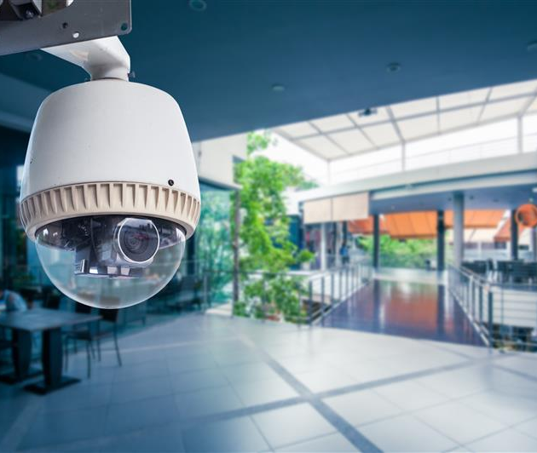

Future Scope
Web application
Mobile application
IOT
Cloud

Slide 12


